Slide 1
Chapter 3 The Unix Connection
Hadeel Ammari, M.C.Sc, MBA
Computer Science Instructor, Foothill Collage

Slide 2
Main Topics
Humans, Machines and Aliens
In the Olden Days, Computers Were Expensive
Host and Terminals
Terminal Rooms and Terminal Servers
The Console
The Unix Connection
Hosts Without Consoles
The Client/Server Relationship
What Happens When You Press a Key?
Character Terminals and Graphics Terminals
The Most Common Types of Terminals

Slide 3
Humans, Machines and Aliens
Terminal
Host
Computer
Input Facility
Output Facility
Terminal
Notes:
An Interface is a way for two separate entities to interact.

Slide 4
In the Olden Days, Computers Were Expensive
No personal computers.
Most computers were large, expensive, temperamental machine that required their own staff of programmers and administrators (Mainframe computers).
Mainframe computers were kept in special rooms called glass rooms
Environment (fragile)
Safety (valuable)
Display (rare)
In the late 1960s and early 1970s, computers were expensive and hard to use.

Slide 5
In the Olden Days, Computers Were Expensive
Need to make computing easier and cheaper
Unix was developed to be
Multitasking (Multiprogramming)
Multiuser (Time-sharing system): this means each user would need his own interface.

Slide 6
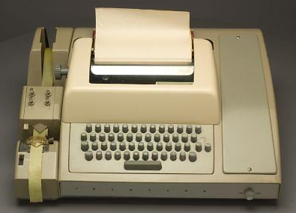
Host and Terminals
Teletype was valuable because it was economical and available.
First multiuser Unix:
Host: single processing element (PDP-11).
Terminals: multiple interface units (teletypes)
This design made Unix flexible and able to work with any computer architecture.

Slide 7
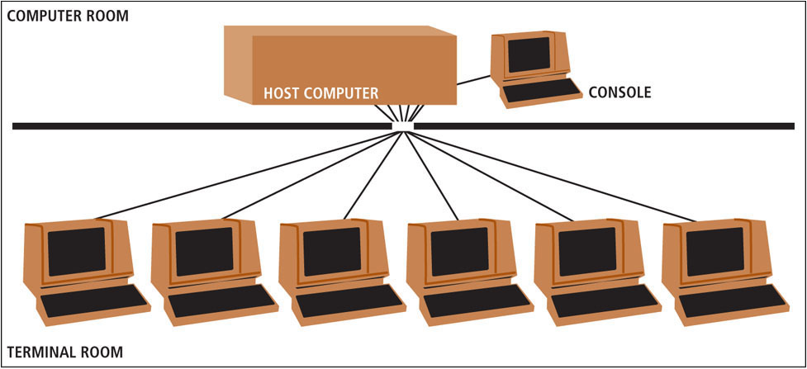
Terminal Rooms and Terminal Servers

Slide 8
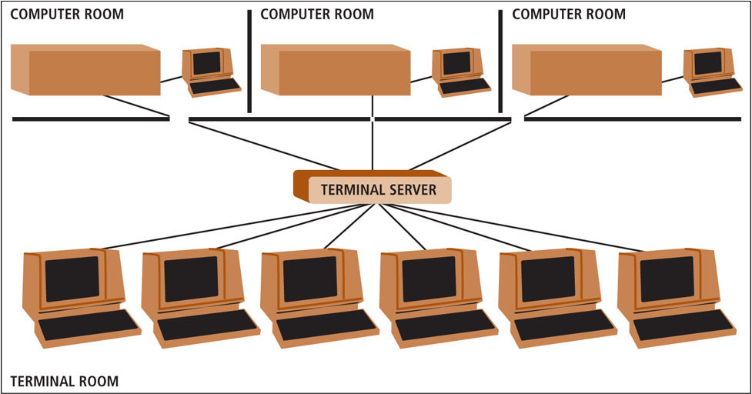
Terminal Rooms and Terminal Servers

Slide 9
The Console
The console is the terminal connected to the computer itself and used to administrate the system.
Why do we need to know about console and regular terminals?
We need to know what it means when learning about Unix
There are certain things that can only be done at the console
Error messages are displayed only on the console

Slide 10
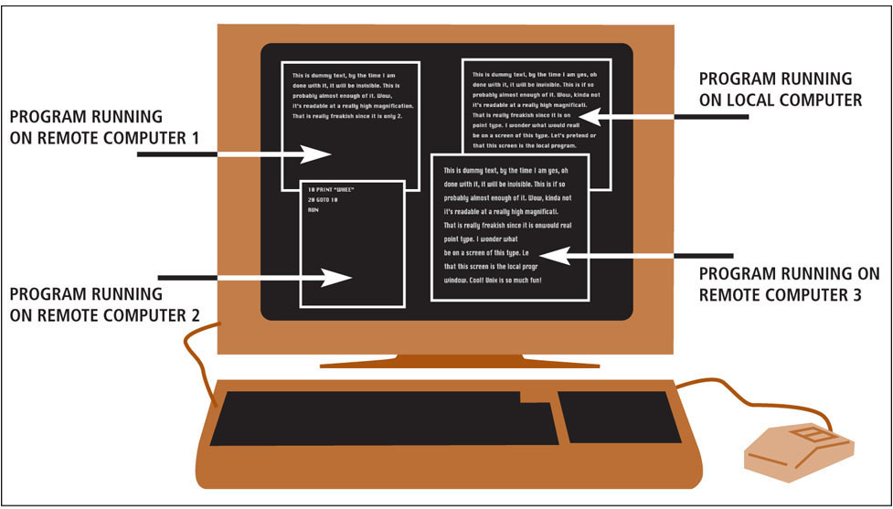
The Unix Connection

Slide 11
Hosts Without Consoles
If a computers that can run on its own, without direct input from a human being, there is no need for a terminal.
These are called headless systems
Examples of headless systems:
Web servers and mail servers
Routers: special-purpose computers that relay data from one network to another.

Slide 12
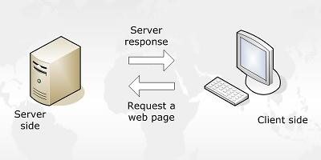
The Client/Server Relationship
Server is a program that offers a service of some type
Client is a program that uses a service.
Examples:
Web client/server
Mail client server (SMTP, POP and IMAP)
Connecting to a host (SSH)
Upload and download files (FTP)
Usenet: the worldwide system of discussion groups

Slide 13
What Happens When You Press a Key?
You press a key, such as <a>
The terminal sends a signal to the host
The host echoes the character to your screen
Why the host echoes each character not the terminal?
Ensure that what you are typing is received successfully and the connection between the host and terminal is intact.
As Unix was designed to work with different terminals, the operating system needs to handles some key presses such as <Backspace> and <Delete>

Slide 14
Character Terminals and Graphics Terminals
Character Terminal or Text-based Terminal is a terminal that only works with text.
Graphics Terminals have a keyboard and a mouse and take full advantage of the video hardware.

Slide 15
The Most Common Types of Terminals
When connecting to a remote terminal, you can use:
A character terminal (emulating VT100)
A graphics terminal (emulating an X terminal)
$ssh host_name
$ssh –X host_name

